Slide 1
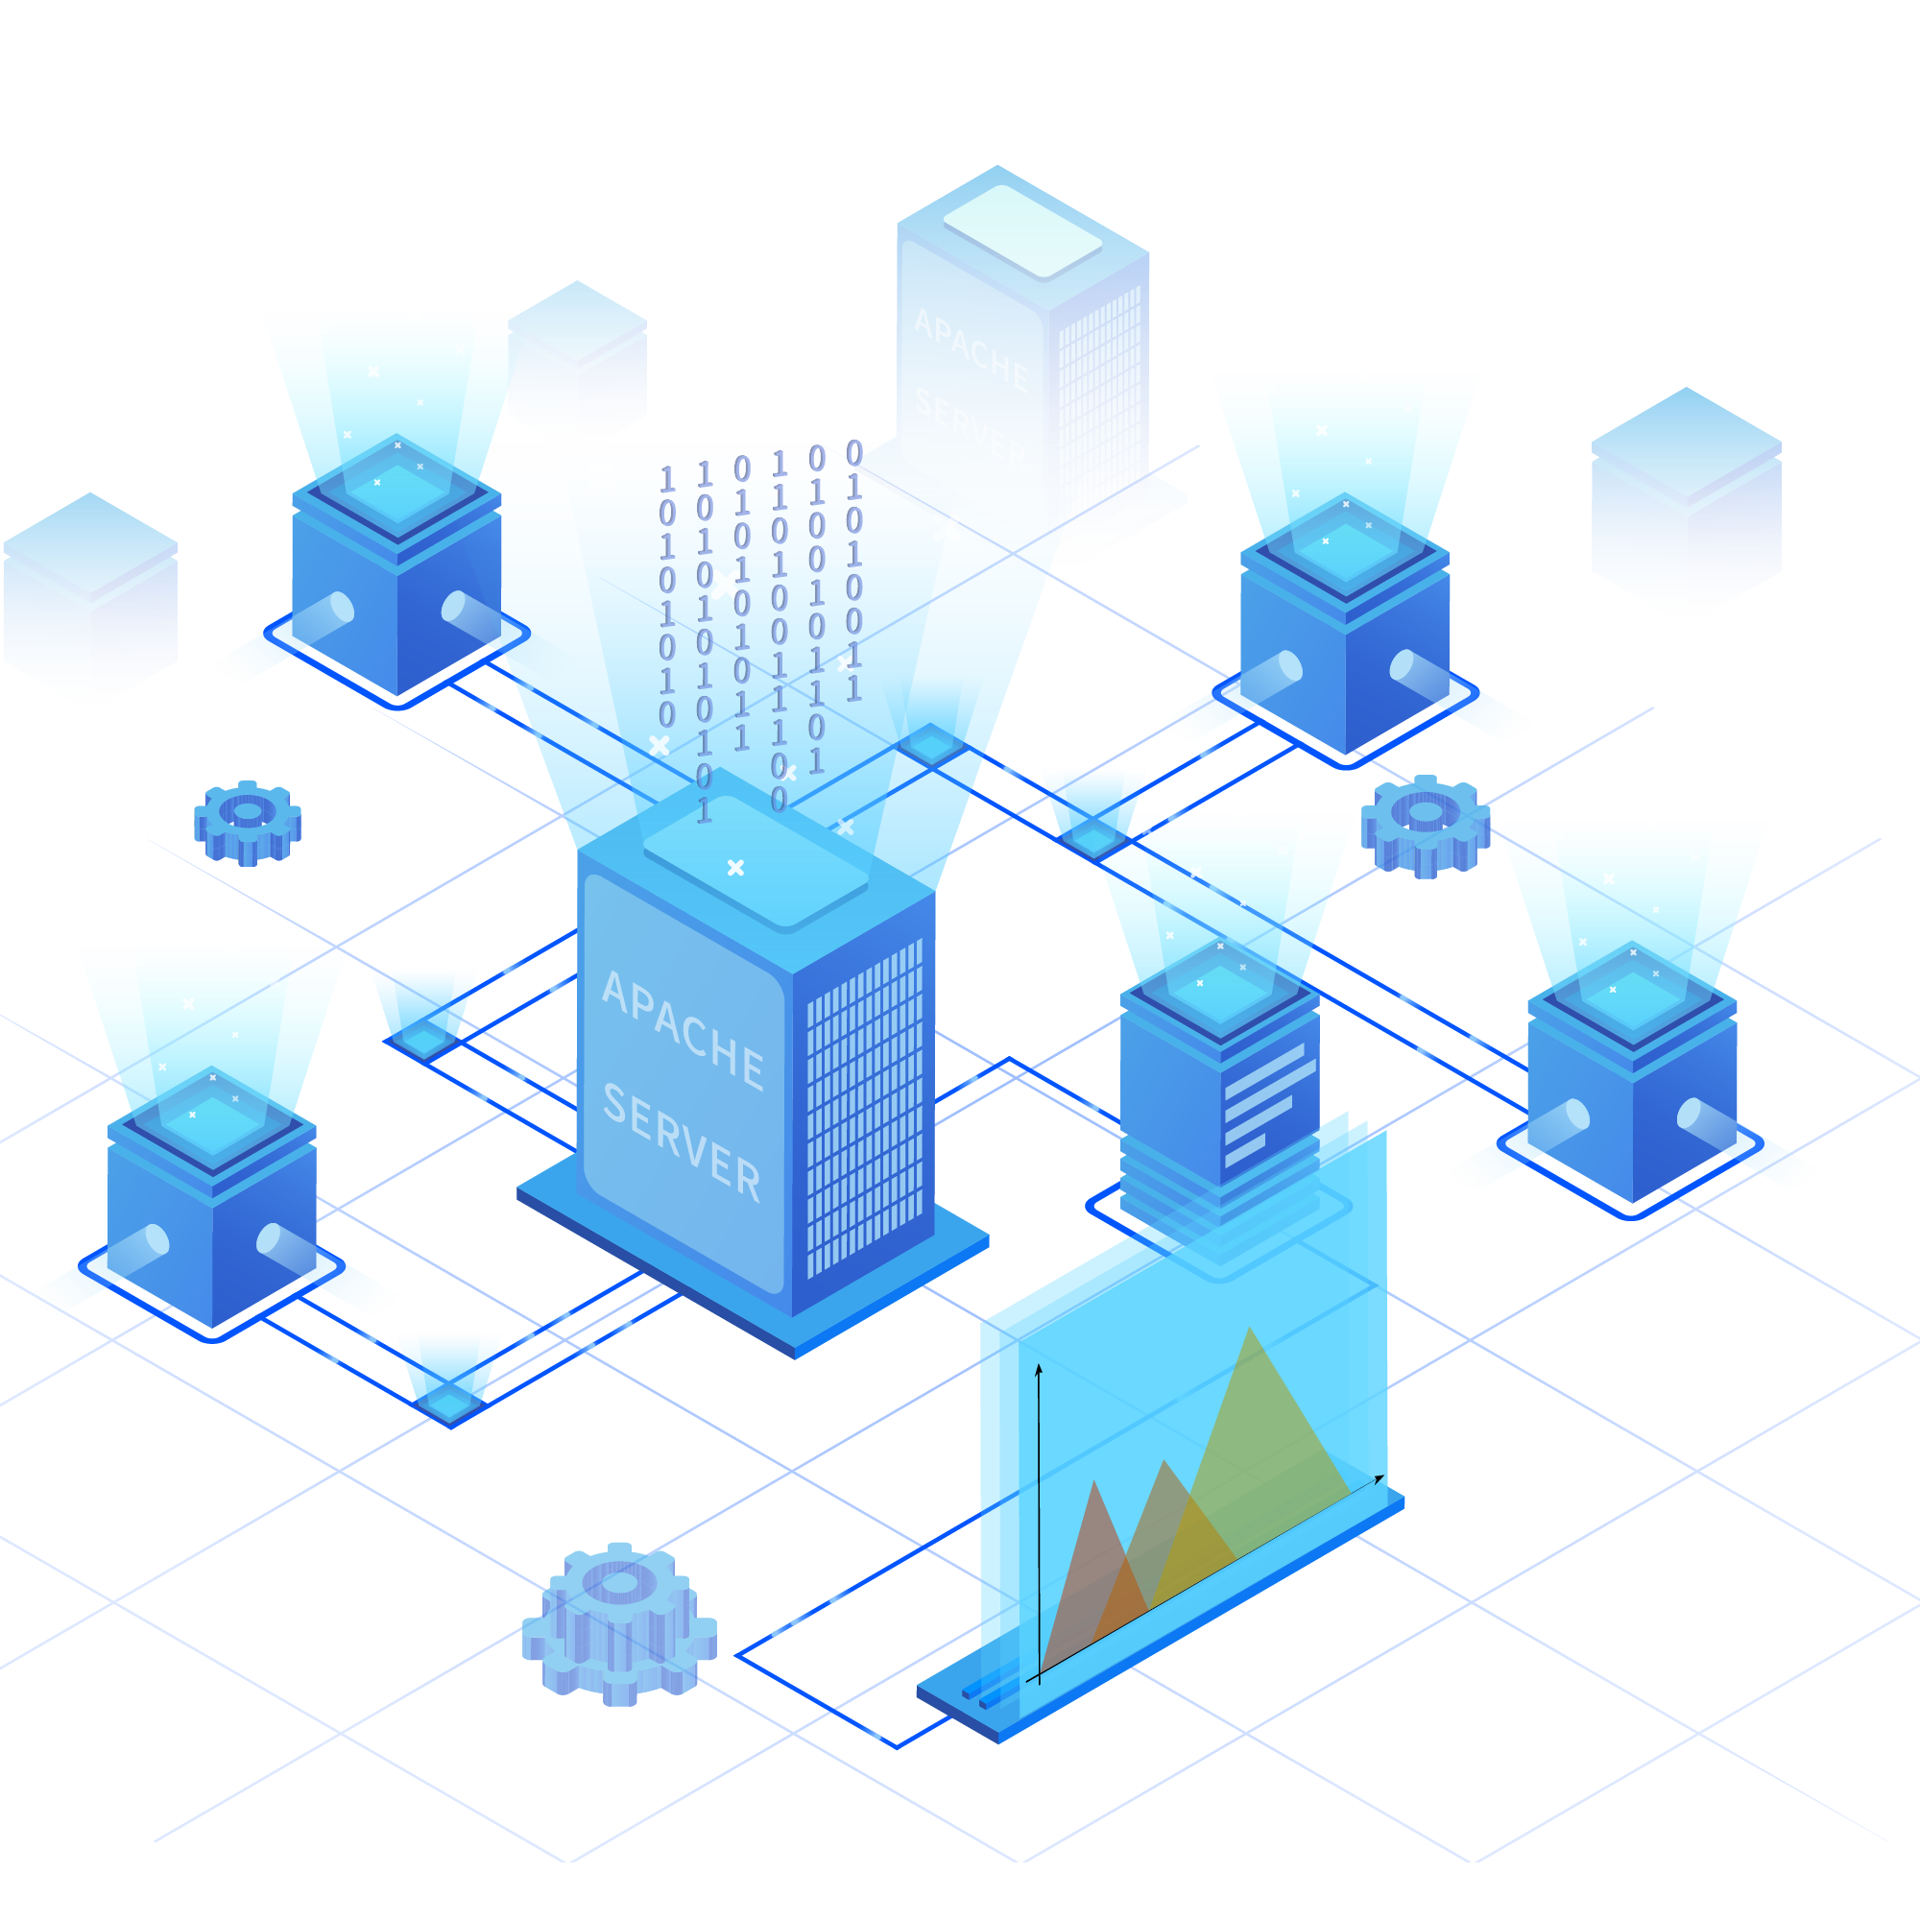
CLOUD COMPUTING
Presented By Mr. Mali Gaurav V.
TYBCA SEM-6
Guided by : Ms. Devmorari Neha G.

Slide 2

Cloud Computing
Nowadays, Cloud computing is adopted by every company, whether it is an MNC or a start-up, many are still migrating towards it because of the cost-cutting, lesser maintenance, and the increased capacity of the data with the help of servers maintained by the cloud providers. One more reason for this drastic change from the On-premises servers of the companies to the Cloud providers is the ‘Pay as you go’ principle-based services provided by them i.e., you only have to pay for the service which you are using. The disadvantage On-premises server holds is that if the server is not in use the company still has to pay for it.

Slide 3
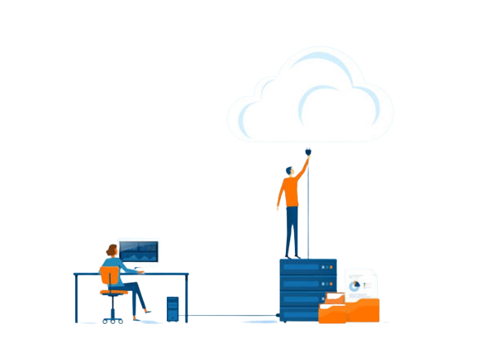
Introduction
What is cloud computing?
Cloud Computing means storing and accessing the data and programs on remote servers that are hosted on the internet instead of the computer’s hard drive or local server. Cloud computing is also referred to as Internet-based computing, it is a technology where the resource is provided as a service through the Internet to the user. The data that is stored can be files, images, documents, or any other storable document.
It allows users to access resources and services on-demand, without the need for physical infrastructure or local servers.

Slide 4
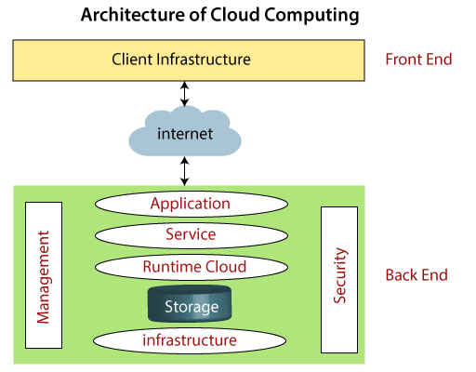
ARCHITECTURE OF CLOUD COMPUTING
As we know, cloud computing technology is used by both small and large organizations to store the information in cloud and access it from anywhere at anytime using the internet connection.
Cloud computing architecture is a combination of service-oriented architecture and event-driven architecture.
Cloud computing architecture is divided into the following two parts -
1.Front End
2.Back End

Slide 5
BASIC CONCEPTS
There are certain services and models working behind the system making the cloud computing feasible and accessible to the end user.
Following are the working models for cloud computing:
Deployment Models
2. Service Models

Slide 6
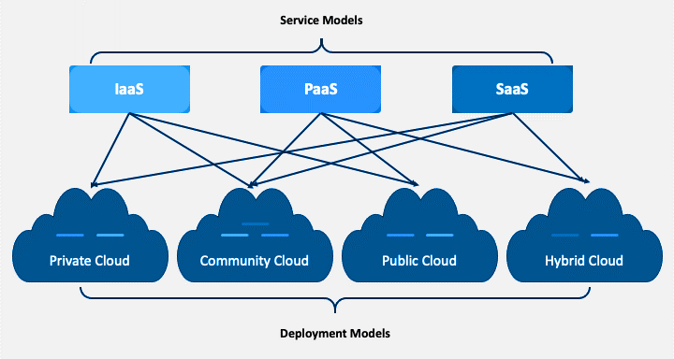
What Is A Cloud Deployment Model?
It works as your virtual computing environment with a choice of deployment model depending on how much data you want to store and who has access to the Infrastructure.
Private Cloud
Community Cloud
Public Cloud
Hybrid Cloud

Slide 7
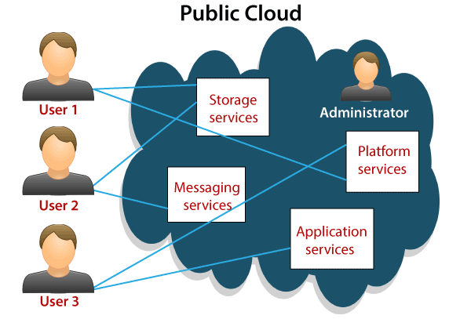
Public Cloud
Services are provided over a public network and available to anyone who wants to use them.
It is a cost-effective option for businesses looking for
scalability and flexibility.
Public cloud providers, such as AWS, Azure, and GCP, offer a wide range of services accessible to the general public
Benefits of Public Cloud
Minimal Investment - As a pay-per-use service,
there is no large upfront cost and is ideal for
businesses who need quick access to resources
No Hardware Setup - The cloud service providers fully fund the entire Infrastructure

Slide 8
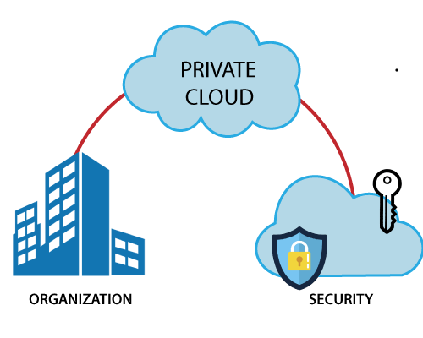
Private Cloud
Infrastructure is dedicated to a single organization and may be located on-premises or off-premises.
Private cloud environments are designed to meet specific security, compliance, or performance requirements.
They offer enhanced control, customization, and
privacy but require significant upfront investment.
Benefits of Private Cloud
Data Privacy - It is ideal for storing corporate data where only authorized personnel gets access.
Security - Segmentation of resources within the same Infrastructure can help with better access and higher levels of security.
Supports Legacy Systems - This model supports legacy systems that cannot access the public cloud

Slide 9
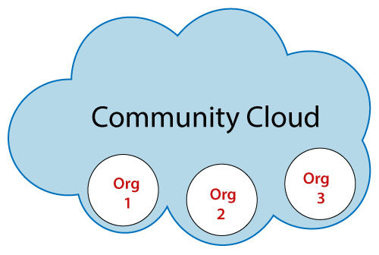
Community Cloud
Community cloud is a deployment model where infrastructure and services are shared among a specific community or group of organizations
It caters to the needs of a particular community, such as government agencies, educational institutions, or research organizations.
Community cloud provides a cost-effective solution while addressing specific requirements and compliance standards of the community.
Benefits of Community Cloud
Smaller Investment - A community cloud is much cheaper than the private & public cloud and provides great performance
Setup Benefits - The protocols and configuration of a community cloud must align with industry standards, allowing customers to work much more efficiently.

Slide 10
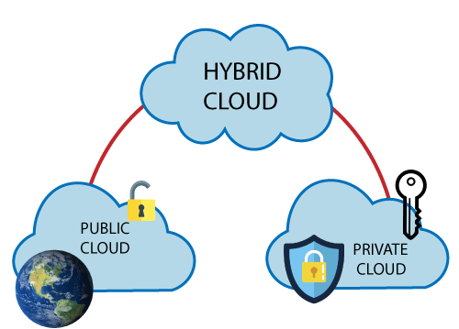
Hybrid Cloud
Combines public and private cloud environments, allowing for flexibility and data sharing between the two.
Organizations can leverage the benefits of both public and private clouds, ensuring optimal resource allocation.
Hybrid cloud deployments enable workload portability
and seamless integration between different environments.
Benefits of Hybrid Cloud
Cost-Effectiveness - The overall cost of a hybrid solution decreases since it majorly uses the public cloud to store data.
Security - Since data is properly segmented, the chances of data theft from attackers are significantly reduced.
Flexibility - With higher levels of flexibility, businesses can create custom solutions that fit their exact requirements

Slide 11
What Is A Cloud Service Model?
Cloud computing makes it possible to render several services, defined according to the roles, service providers, and user companies. Cloud computing models and services are broadly classified as below:
IAAS
PAAS
SAAS

Slide 12
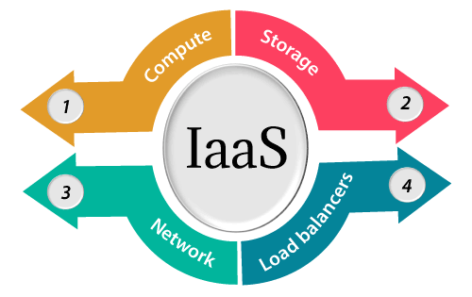
IAAS- Infrastructure as a Service
The Infrastructure as a Service (IAAS) means the hiring & utilizing of the Physical Infrastructure of IT (network, storage, and servers) from a third-party provider. The IT resources are hosted on external servers, and users can
access them via an internet connection.
IAAS is also known as Hardware as a Service (HAAS). It is one of the layers of the cloud computing platform. It allows customers to outsource their IT infrastructures such as servers, networking, processing, storage, virtual machines, and other resources. Customers access these resources on the Internet using a pay-as-per use model.
The Benefits
Time and cost savings: No installation and maintenance of IT hardware in-house.
Better flexibility: On-demand hardware resources that can be tailored to your needs.
Remote access and resource management.

Slide 13
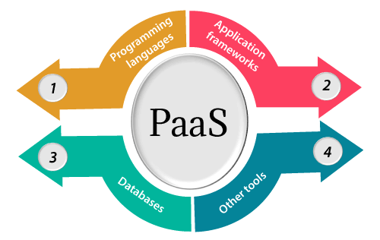
PAAS- Platform as a Service
Platform as a Service (PaaS) provides a runtime environment. It allows programmers to easily create, test, run, and deploy web applications. You can purchase these applications from a cloud service provider on a pay-as-per use basis & access
them using the Internet connection. In PaaS, back end scalability
is managed by the cloud service provider, so end- users do
not need to worry about managing the infrastructure
PaaS includes infrastructure (servers, storage, and networking) and platform (middleware, development tools, database management systems, business intelligence, and more) to support the web application life cycle.
The Benefits
Focus on development: Mastering the installation and development of software applications.
Time saving and flexibility: no need to manage the implementation of the platform, instant production.

Slide 14
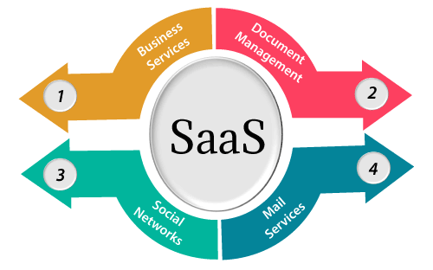
SAAS- Software as a Service
SaaS is also known as "On-Demand Software". It is a software distribution model in which services are hosted by a cloud service provider. These services are available to end-users over the internet so, the end-users do not need to install any software on their devices to access these services.
Software as a Service (SaaS) is provided over the internet and requires no prior installation. The services can be availed from any part of the world at a minimal per-month fee.
The Benefits
You are entirely free from the infrastructure management and aligning software environment: no installation or software maintenance.
You benefit from automatic updates with the guarantee that all users have the same software version.
It enables easy and quicker testing of new software solutions.

Slide 15
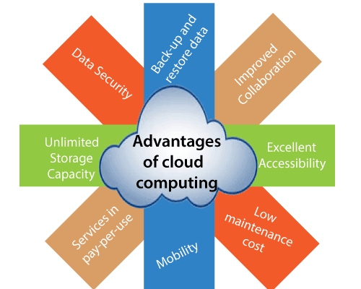
Advantages of Cloud Computing
1) Back-up and restore data: Once the data is stored in the cloud, it is easier to get back-up and restore that data using the cloud.
2) Improved collaboration: Cloud applications improve collaboration by allowing groups of people to quickly and easily share information in the cloud via shared storage.
3) Low maintenance cost: Cloud computing reduces both hardware and software maintenance costs for organizations.
4) Unlimited storage capacity: Cloud offers us a huge amount of storing capacity for storing our important data such as documents, images, audio, video, etc. in one place.
5) Data security: Data security is one of the biggest advantages of cloud computing. Cloud offers many advanced features related to security and ensures that data is securely stored and handled.
6) Mobility: Cloud computing allows us to easily access all cloud data via mobile.

Slide 16
Disadvantages of Cloud Computing
Internet Connectivity:As you know, in cloud computing, every data (image, audio, video, etc.) is stored on the cloud, and we access these data through the cloud by using the internet connection. If you do not have good internet connectivity, you cannot access these data. However, we have no any other way to access data from the cloud.
2) Vendor lock-in: Vendor lock-in is the biggest disadvantage of cloud computing. Organizations may face problems when transferring their services from one vendor to another. As different vendors provide different platforms, that can cause difficulty moving from one cloud to another.
3) Limited Control: As we know, cloud infrastructure is completely owned, managed, and monitored by the service provider, so the cloud users have less control over the function and execution of services within a cloud infrastructure.
4) Security: Although cloud service providers implement the best security standards to store important information. But, before adopting cloud technology, you should be aware that you will be sending all your organization's sensitive information to a third party, i.e., a cloud computing service provider. While sending the data on the cloud, there may be a chance that your organization's information is hacked by Hackers.

Slide 17
Conclusion
Cloud computing provides advanced computing resources available on-demand, that scale as needed, with regular updates and without the need to buy and maintain an on-premise infrastructure. With cloud computing, teams become more efficient and reduce time to market as they can rapidly acquire, scale services, without the considerable effort that requires managing a traditional on-premise infrastructure.
Cloud computing is a technology that provides on-demand, scalable, and updated computing resources. It offers many advantages to different types of users and organizations, such as cost savings, flexibility, and collaboration. However, it also faces some challenges, such as security and integration issues. Cloud computing is a fast-growing and evolving part of network-based computing.

Slide 18
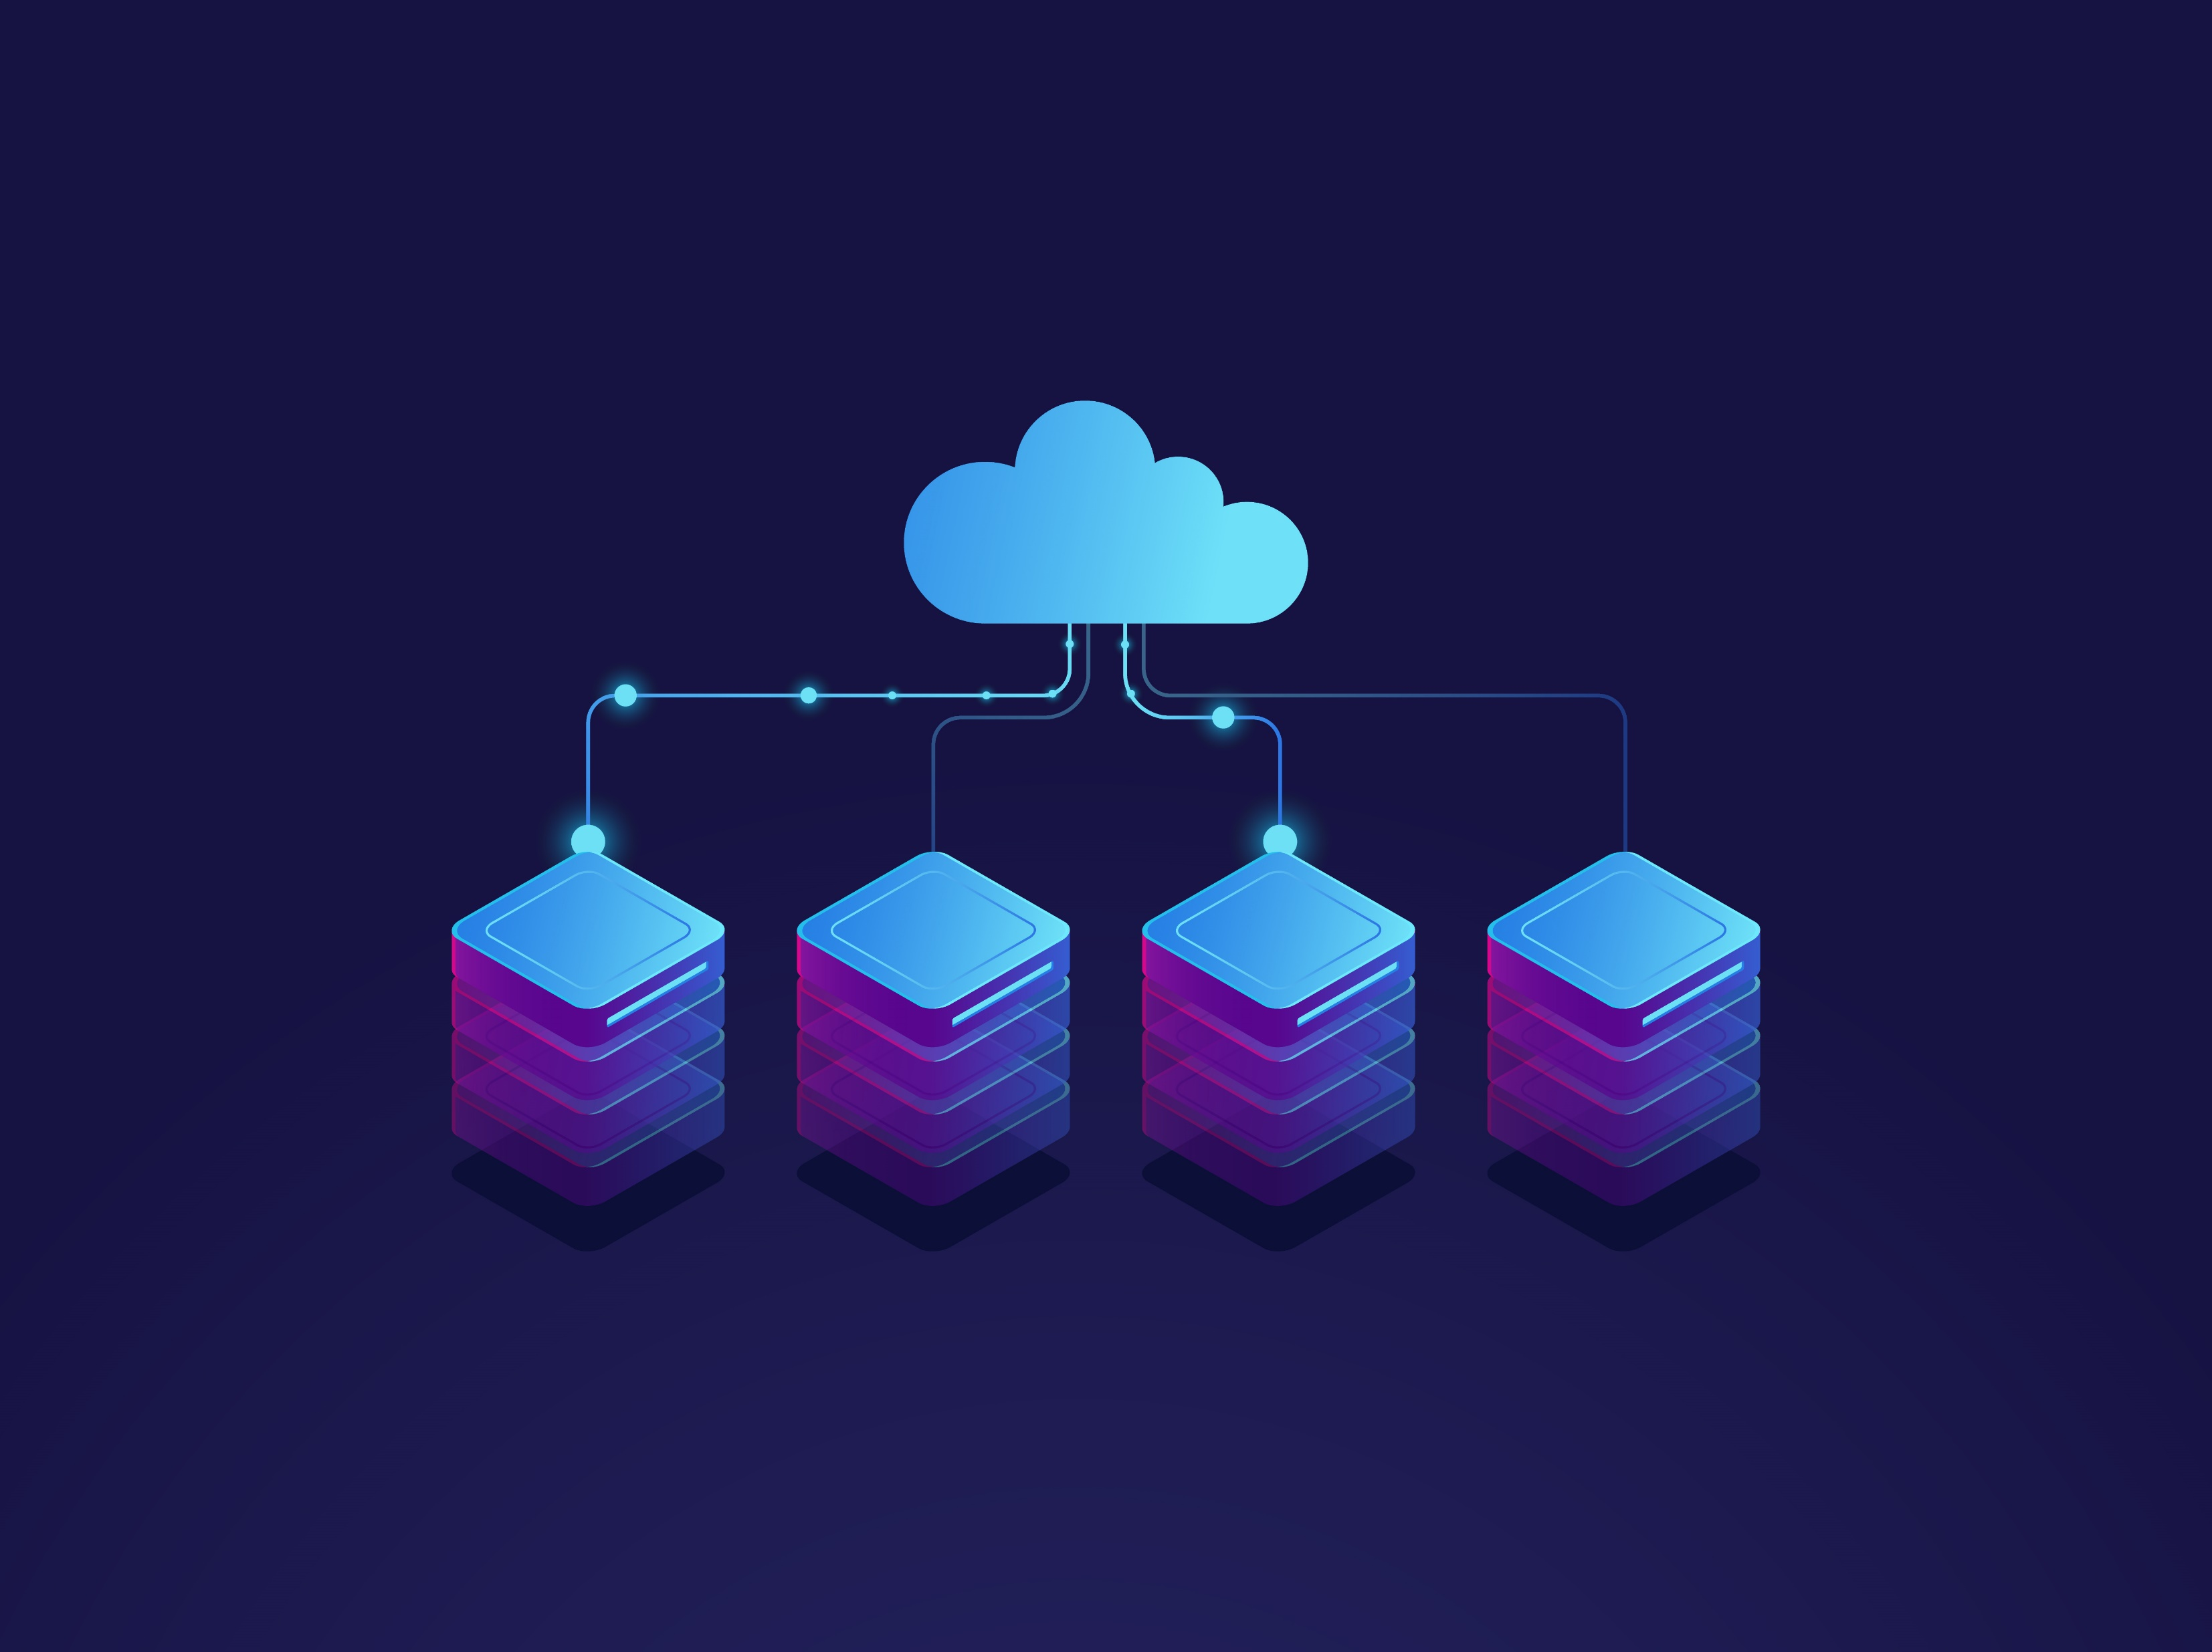
THANK YOU

